Slide 1
Stylegan Style Transfer
Cameron Barrie

Slide 2
Stylegan Background
Uses generative adversarial networks (GANs) to transfer style from one image to another
Replaces traditional GAN input layer with a learned constant
Can manipulate styles at three different levels of granularity

Slide 3
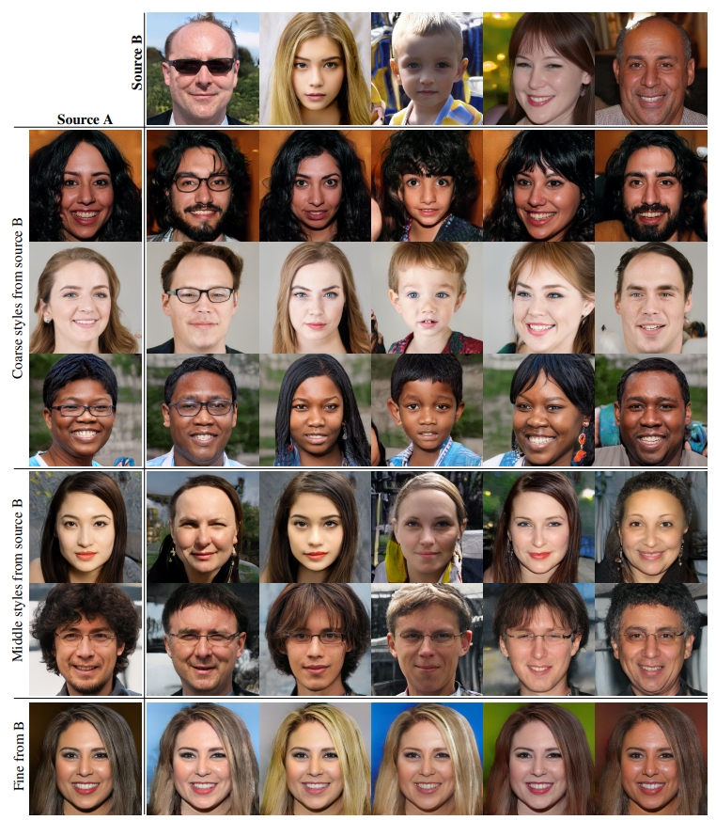
Example Style Transfers
Styles transferred from Source B images Source A images
Three granularities
Course (4² – 8² pixels): pose, hair style, face shape, glasses, etc.
Middle (16² – 32² pixels): detailed hair style, eyes, etc.
Fine (64² – 1024² pixels): color scheme, microstructure, etc.

Slide 4
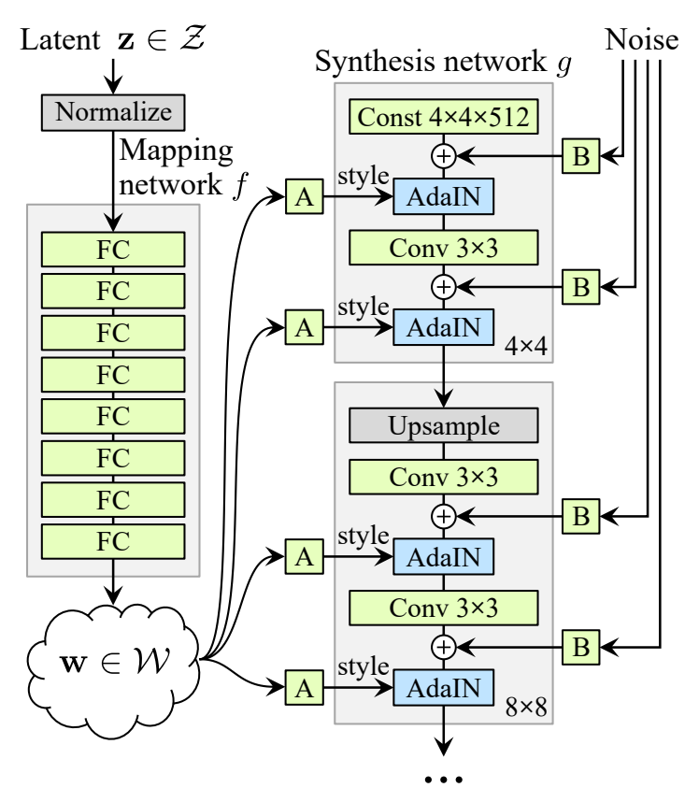
How Stylegan works
Mapping network: pass z (512 element vector) through 8-layer MLP to produce w (18 x 512 matrix)
Used to disentangle data (necessary to “fill” gaps where feature combinations are absent)
Normalization of “A”
adaptive instance method (AdaIN)
includes style information

Slide 5
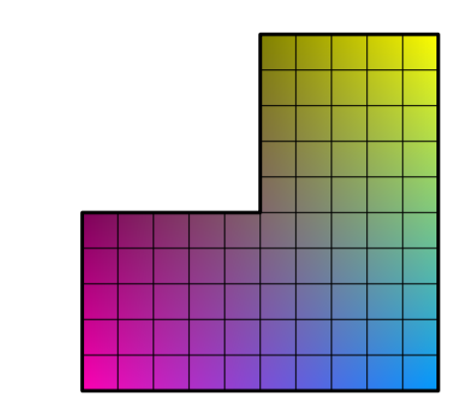
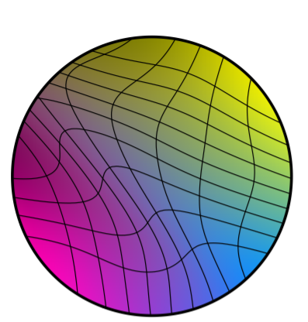
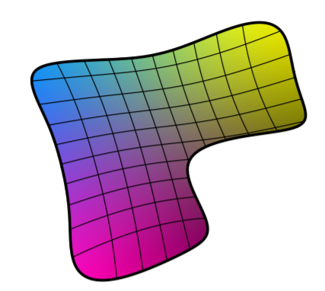
Mapping Network Disentanglement
Example distribution of stylegan training set for two variables with incomplete data e.g.:
men with long hair
women with beards
etc.
Distribution of vectors z in Z
Warped to prevent sampling of non-existent feature combinations
Reconstruction of original feature space using mapping network
Attempts to remove warping

Slide 6
Going Beyond Stylegan
Apply trained network to a given image (that is not in the training set)
Develop interface allowing users to upload photos
Allow users to apply Stylegan to their own images For example:
Selecting one of a collection of images from which the style will be transferred to the uploaded image
Selection of style granularity to apply to the uploaded image

Slide 7
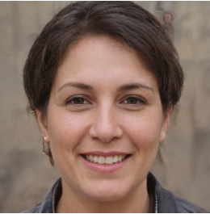
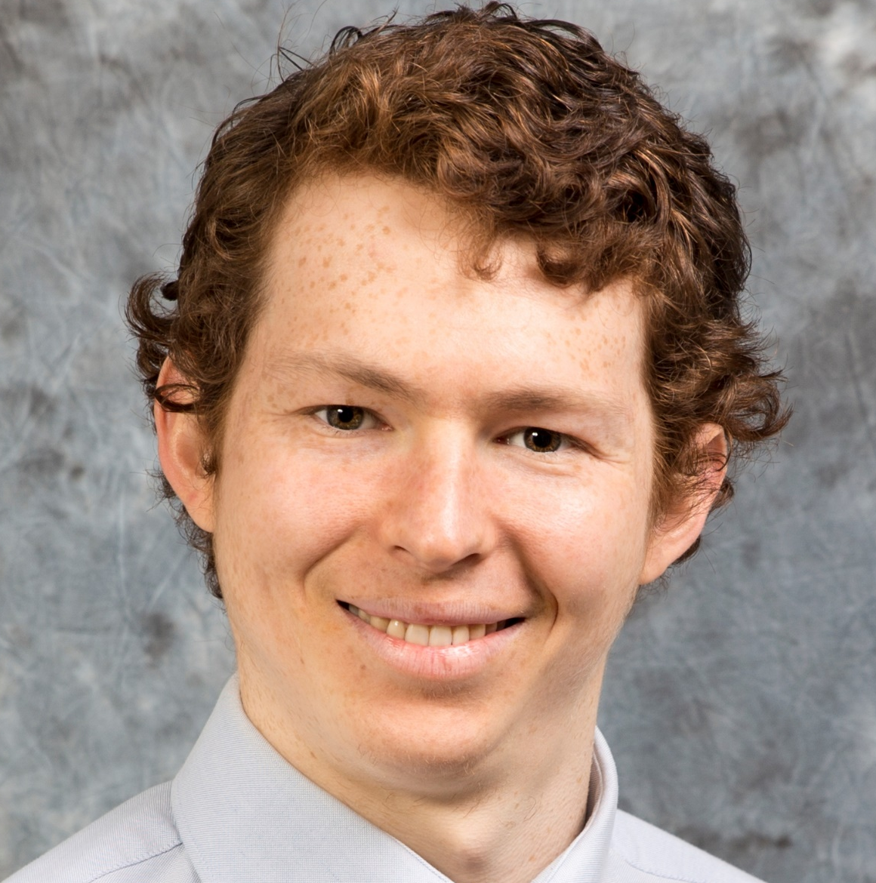
Example Usage
Style Transfer Image
?
Uploaded Image

Slide 8
Problem
Stylegan latent space made up of only synthetic training images
Need a way to convert real images to stylegan latent space

Slide 9
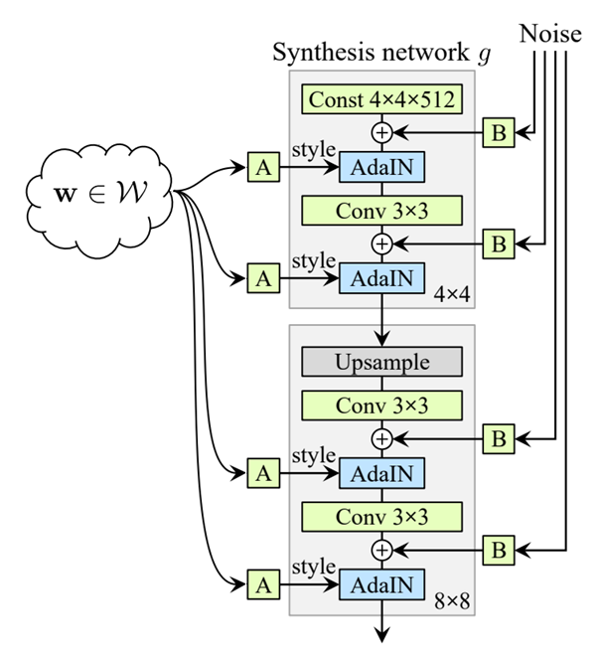
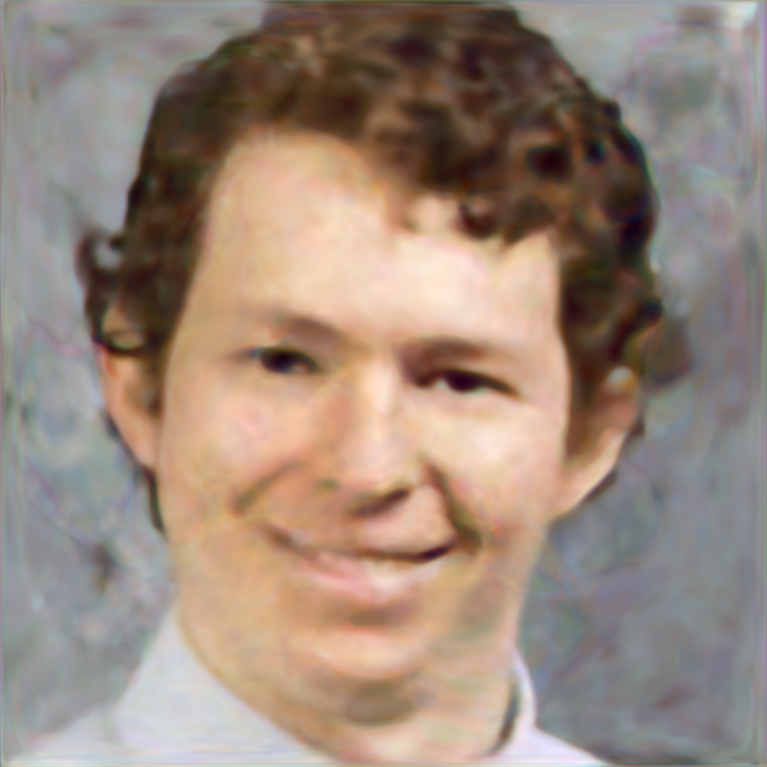
Convert Image to Latent Space (Z or W)
Evaluate loss and update w value

Slide 10
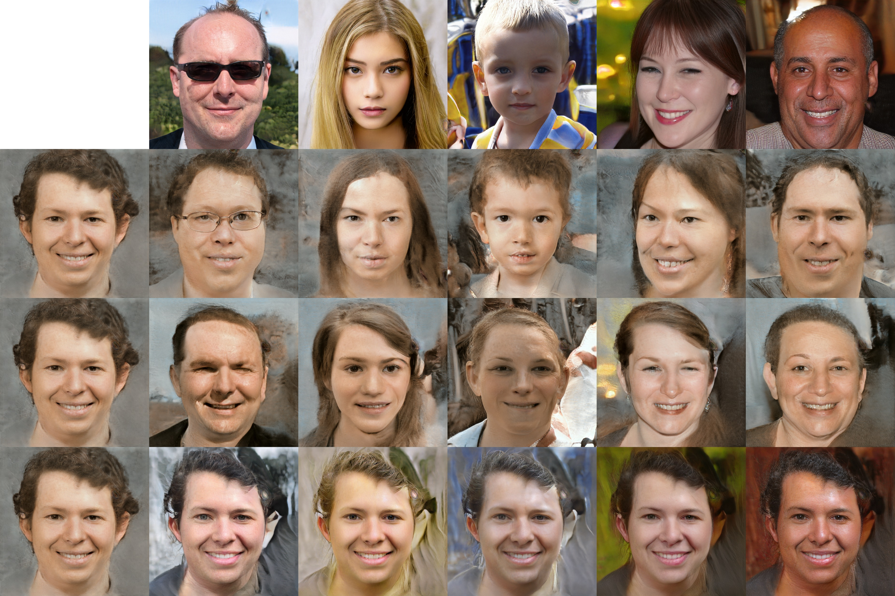
Goal
From Image
To Image
High Level
Medium Level
Low Level

